Slide 1

T.R.E.N.D. Tracking Real Estate and Neighbourhood Data (NSW)
PROJECT 3 | Rajani Muttumula , Natasha Elliott, Lishi Cai, Michael Luc

Slide 2
DATA AND RESEARCH
Introduction Our motivation was to research and compare housing prices across different localities throughout NSW. To do so we have sourced data from the NSW Valuer General, which keeps historical records for property sales in the state, and which provides us with both pricing, location and settlement date data. We then took a slice of these records, and analysed the period of time between 2021 and 2024.
Datasource https://valuation.property.nsw.gov.au/embed/propertySalesInformation
Methods ETL: Data storage and retrieval -Python: Polars, Flask, and glob -SQL

Slide 3
POLA.RS VS PANDAS
After researching the many Data Engineering libraries available to us, our team settled on replacing Pandas with Polars. Polars is an open-source library for data manipulation, and is known for being one of the fastest data processing solutions available.
Polars required us to learn a new set of syntax, and to adapt our current Pandas knowledge to a new, but similar framework. Polars and Pandas both use dataframes, meaning that while we had to learn new ways to call the same functions, once we could figure those out we could model the ETL pipeline similarly to our past Pandas work.
Pros
Speed: Extremely fast due to Rust implementation and multi-threading.
Memory Efficiency: Lazy evaluation minimizes memory usage.
Handles Large Datasets: Works with datasets larger than RAM via out-of-core computation.
Immutable DataFrames: Avoids side effects, making debugging easier.
Supports Popular Formats: Efficient reading/writing of CSV, DAT, and JSON.
Cons
Smaller Ecosystem: Fewer third-party integrations compared to Pandas.
Smaller Community: Less support and fewer resources available online.
Steeper Learning Curve: Less intuitive for users accustomed to Pandas.

Slide 4
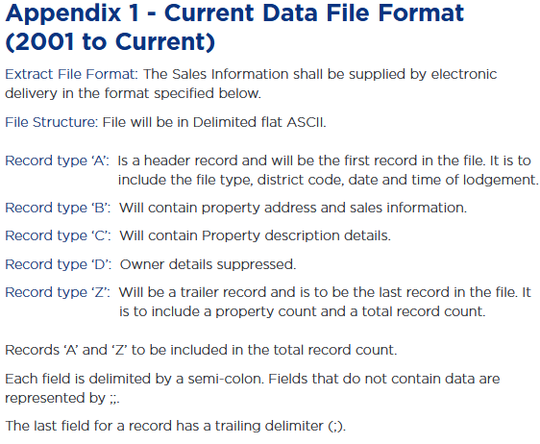
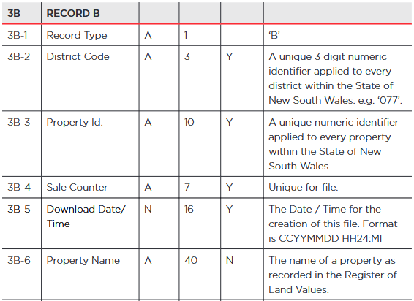
DATA PREPARATION AND CLEANING
The raw data sourced from NSW Valuer General was in DAT format. We imported all the data and then combined them into a single Polars dataframe. After sourcing the dataset’s User Guide from the NSW Valuer General website, we determined the only records required were records matching type ‘B’.
Notes:
.dat files

Slide 5
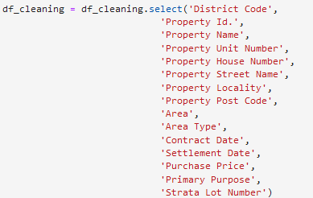
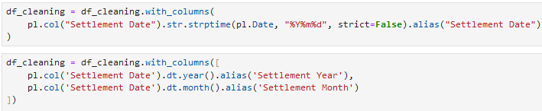
DATA PREPARATION AND CLEANING
After filtering the data to only include Record type ‘B’, the data remaining was still excessively large containing 24 columns, many of which were irrelevant to our analysis. In these 24 columns, the following were relevant:
We converted the Property ID and Purchase Price columns to integers, and the Settlement Date column from a string to a datetime in order to allow us to group the data by days, months, and years. This was then split into separate columns, so we were able to filter by year:

Slide 6
csv.files generated: Each table offers a different way of viewing the original property sales dataset.
Grouped:by settlement year and locality
Units.csv
Units_grouped.csv
Cleaned.csv
split
Grouped:by settlement year and locality
House.csv
House_grouped.csv
Choose SQL to create database:
Structured Data
Consistency and reliable transactions.

Slide 7
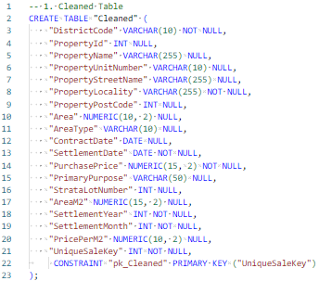
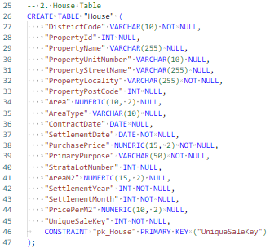
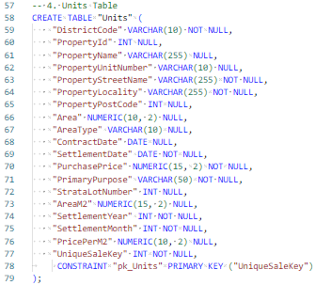


SQL TABLES

Slide 8
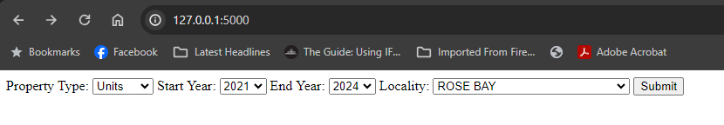
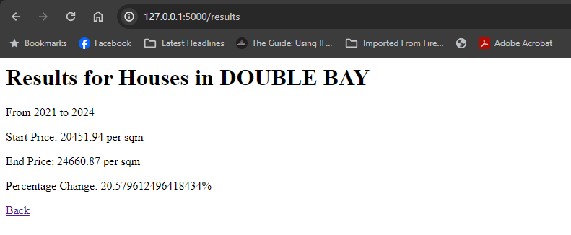
FLASK APP
It allows for a quick and easy way to access the housing data price for each locality.

Slide 9
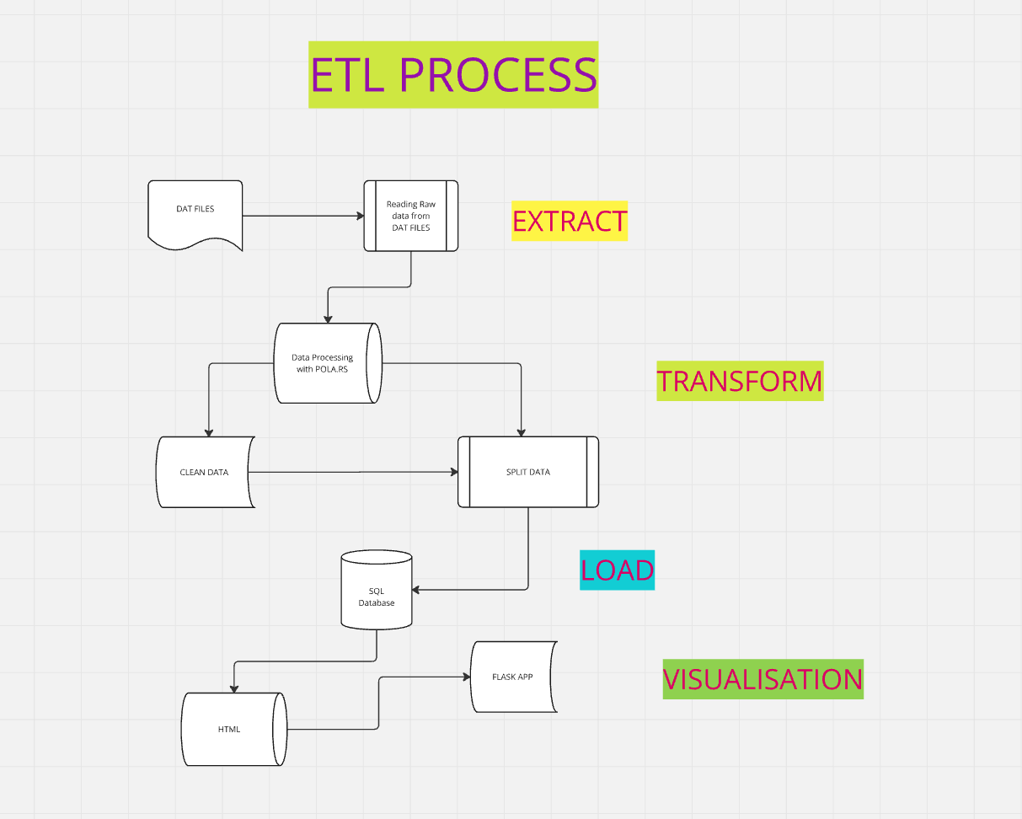
ETL PROCESS DIAGRAM

Slide 10
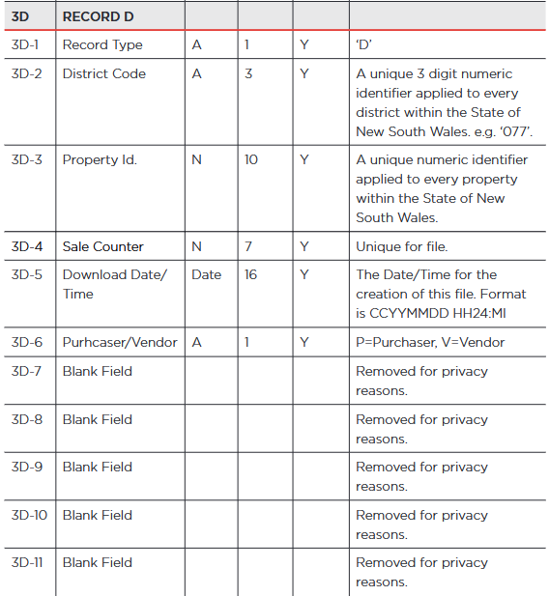
ETHICAL CONSIDERATIONS
The original dataset was sourced from the NSW Valuer General's website and is made available under the Creative Commons BY-NC-ND 4.0 license. This means the data cannot be used for commercial purposes. While we performed data cleaning and editing to prepare it for analysis, no significant changes were made to the underlying data.
Given that our project involved data with potential intersections with personal information, we carefully considered the ethical implications of how we processed, stored, and analyzed the dataset.
Protection of Lodger Information: The dataset includes records under "Record Type 'D'," which relate to the person lodging the sale. Fortunately, the NSW Valuer General has already removed any personally identifiable information from these records before making them publicly available, ensuring compliance with Australian privacy laws.
Removal of Exact Addresses: To further protect privacy, we took additional steps to remove exact street addresses from sales records (classified as "Record Type 'B'"). Since our focus was on analyzing broader suburb-level trends, this detailed address information was unnecessary for our analysis. By removing it, we reduced the risk of identifying private individuals through the data.

Slide 11
SUMMARY
We analyzed NSW property housing data from 2021 to 2024. To efficiently handle the large dataset, we used Polars instead of Pandas, leveraging its lightweight and high-performance capabilities for data processing.
A streamlined ETL pipeline was created to transform and clean the dataset. This process involved filtering and sorting and cleaning the data within a Polars DataFrame to remove personal information and irrelevant entries, ensuring compliance with privacy requirements and focusing on meaningful insights.
After cleaning, the Polars DataFrame was exported as a CSV file and imported into a SQL database, allowing for structured storage and querying.
To enhance accessibility, we developed and deployed a Flask application. The app interacts with the SQL database, providing a user-friendly interface for exploring the processed dataset.

